Slide 1
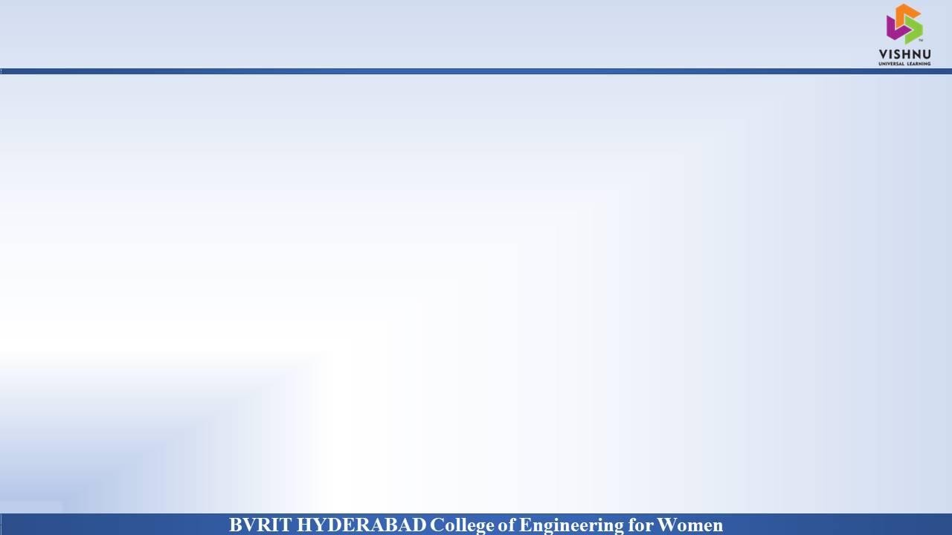
Department of Computer Science and Engineering
Analysis and Prediction of Occupational Accidents
Date: 22 April 2021
K. Kavya : 17WH1A0532
M. Nikhila Shinu : 17WH1A0552
V. Hari Chandana : 17WH1A0515
G. Sravani : 18WH5A0509
Internal Guide : Mr. C Naga Raju
Designation : Assistant Professor

Slide 2


Abstract
Why Should I Study this course?
Examples
BVRIT HYDERABAD College of Engineering for Women
Workplace safety is a major concern in many countries. Among various industries, construction sector is identified as the most hazardous work place. Construction accidents not only cause human sufferings but also result in huge financial loss. To prevent reoccurrence of similar accidents in the future and make scientific risk control plans, analysis of accidents is essential.
The main aim of the proposed system is to provide safety to workers at construction site from accidents by analyzing past accident data by using machine learning algorithms and text mining technique

Slide 3
Dataset
Why Should I Study this course?
Examples
BVRIT HYDERABAD College of Engineering for Women
Dataset Description:
The OSHA dataset contains abstracts of the accidents and injuries of construction workers from 2015-2017. There is some structured data around the unstructured text abstracts, such as Degree of Injury, Body Part(s) Affected, and Construction End Use.
This is OSHA data which is publicly available.
Some of the columns of the dataset:
Event Date
Abstract Text
Event Description
Event Keywords
Degree of Injury
Nature of Injury
Part of Body
Event type
Task Assigned

Slide 4

Architecture
Why Should I Study this course?
Examples
BVRIT HYDERABAD College of Engineering for Women
Data Source
Data Cleaning
Data Preprocessing
Data Analysis
Model and Train data
Evaluate Model
Prediction
Output

Slide 5
Technology Stack
Why Should I Study this course?
Examples
BVRIT HYDERABAD College of Engineering for Women
Machine Learning
Tkinter
Python Programming Language
Anaconda - Jupyter notebook
Required packages
numpy
pandas
sklearn
tkinter
Matplotlib
nltk

Slide 6
Algorithm Models / classifiers
Why Should I Study this course?
Examples
BVRIT HYDERABAD College of Engineering for Women
Decision Tree
Random Forest
Naïve Bayes
Logistic Regression
SVM
KNN
VotingClassifier

Slide 7
System Requirements
Why Should I Study this course?
Examples
BVRIT HYDERABAD College of Engineering for Women
ENVIRONMENT | SPECIFICATIONS
HARDWARE | Processor - Any Intel Processor Memory(RAM) - 4 GB and more Speed - 1GHZ and more
SOFTWARE | Python3 OS - Windows 10 Anakonda-Jupyter notebook

Slide 8
TimeLine
Why Should I Study this course?
Examples
BVRIT HYDERABAD College of Engineering for Women
Review 0 | Abstract Requirements and Specifications
Review 1 | Dataset collection Data Architecture Technology Stack
Review 2 | Data Cleaning Data Preprocessing Data Analysis
Review 3 | Applying of Classification Algorithms Interpretation of Results

Slide 9
References
Why Should I Study this course?
Examples
BVRIT HYDERABAD College of Engineering for Women
Base paper
https://drive.google.com/file/d/1RxbXio-BwYBT4k8pTsy3oVyZCtHTPi2i/view?usp=sharing
Reference papers
https://www.researchgate.net/publication/315644460_Prediction_of_Occupational_Accidents_Using_Decision_Tree_Approach
https://lib.dr.iastate.edu/cgi/viewcontent.cgi?article=8629&context=etd

Slide 10
Thank you

